Slide 2
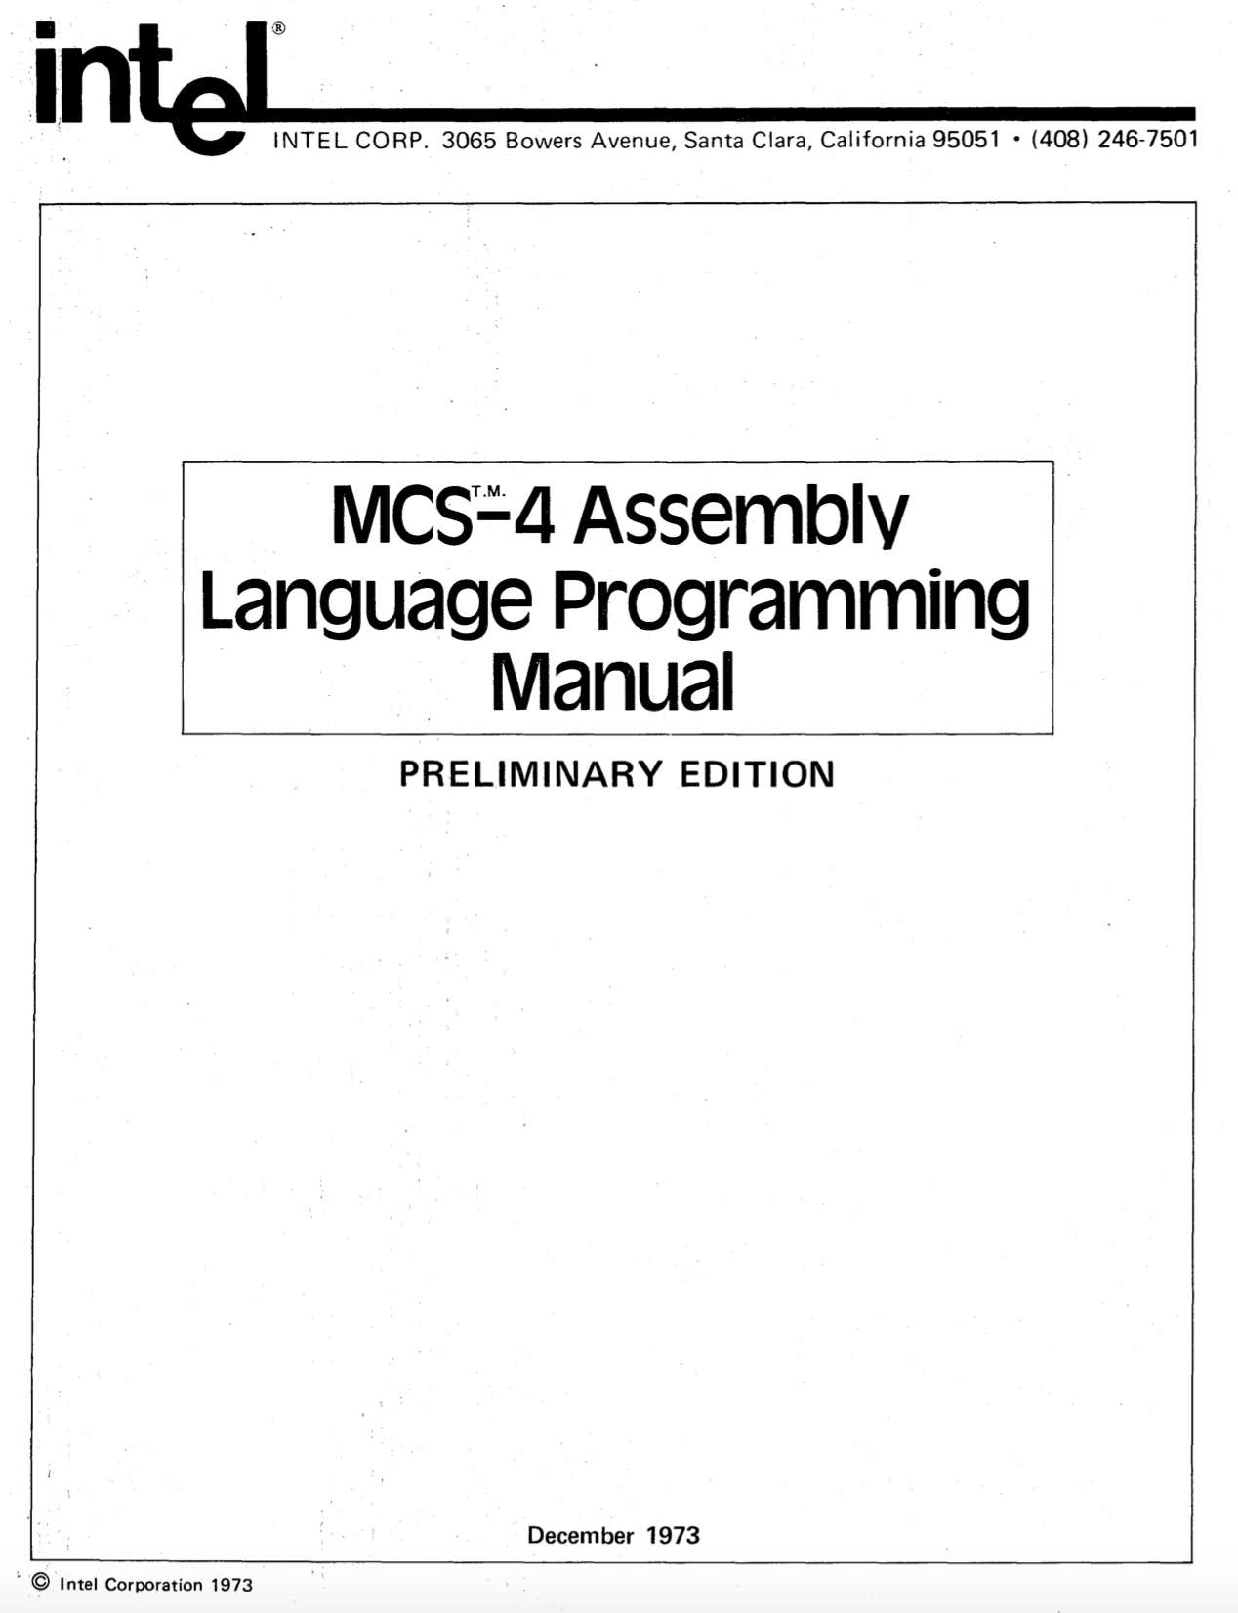

https://github.com/alshapton/Pyntel4004
Assembly Language
Programming Manual
July 2021
Andrew Shapton 2021

Slide 3
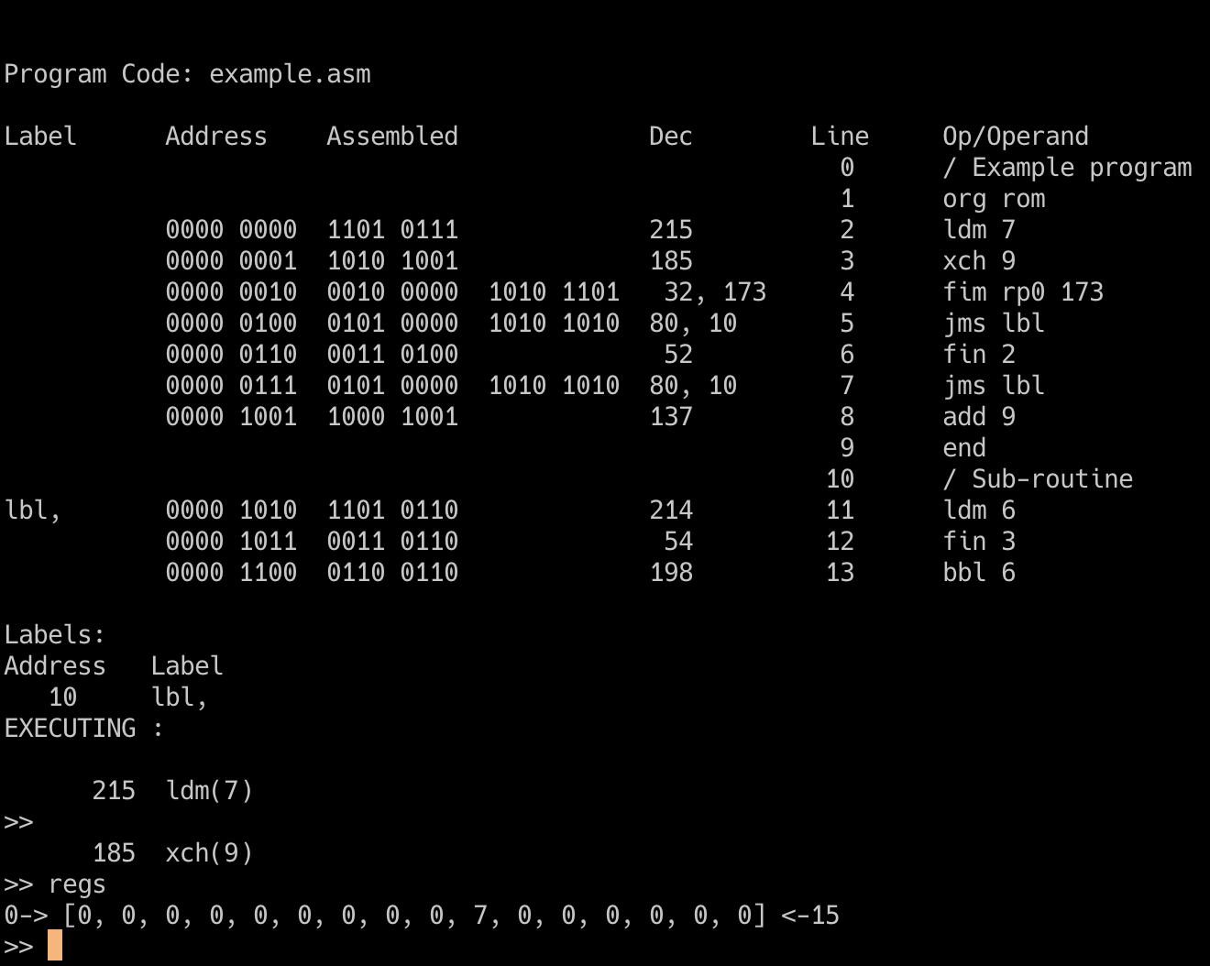
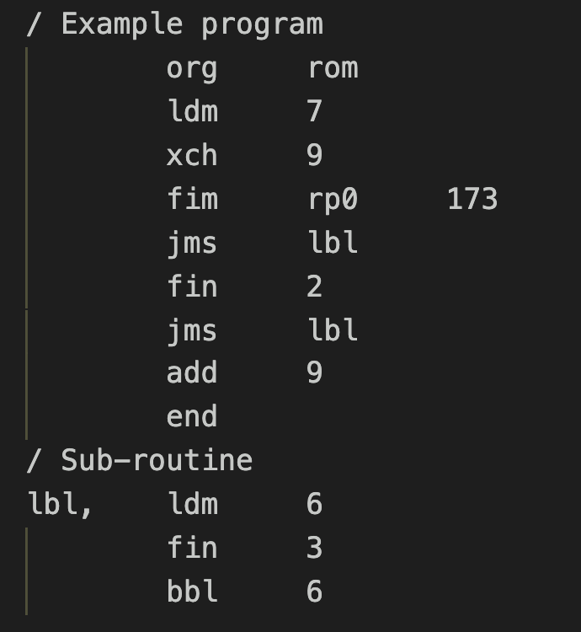

Slide 4
0 0 0 1 C₁ C₂ C₃ C₄
A₂ A₂ A₂ A₂ A₁ A₁ A₁ A₁
If C₁C₂C₃C₄ is true:
A₂A₂A₂A₂ PM A₁A₁A₁A₁ PL
PH unchanged if C₁C₂C₃C₄ is false: (PH) PH
(PM) PM
(PL + 2) PL
C₁ C₂ C₃ C₄
If the indicated Condition Bit is = 1:
Jump if the 4004 Test Signal is = 0
Jump if the Carry Bit is = 1
Jump if the Accumulator = 0
Invert ALL the other conditions
JUMP = C₁ * ((ACC = 0) * C₂ + (carry = 1) * C₃ + TEST * C₄ +
C₁ * (((ACC <> 0) + C₂ ) + ((carry = 0) + C₃ ) * (TEST + C₄ )
JCN

Slide 5
0 0 1 0 R_{p} R_{p} R_{p} 0
D₁ D₂D₃ D₄ D₅ D₆ D₇D₈
0 0 1 0 R_{p} R_{p} R_{p} 0
000 for register pair 0 or 0P
001 for register pair 2 or 1P
010 for register pair 4 or 2P
011 for register pair 6 or 3P
100 for register pair 8 or 4P
101 for register pair 10 or 5P
110 for register pair 12 or 6P
111 for register pair 14 or 7P
8-bit data quantity
000 for register pair 0 or 0P
001 for register pair 2 or 1P
010 for register pair 4 or 2P
011 for register pair 6 or 3P
100 for register pair 8 or 4P
101 for register pair 10 or 5P
110 for register pair 12 or 6P
111 for register pair 14 or 7P
D₁D₂D₃D₄
R_{p} R_{p} R_{p} R_{p}
(RP_{p})
DB(x2)
D₅D₆D₇D₈
R_{p+1} R_{p+1} R_{p+1} R_{p+1}
(RP_{p+1})
DB(x3)
FIM
SRC 1

Slide 6
When referring to a DATA Ram character
When referring to a DATA RAM status character
1 of 16 characters within the register
Not relevant
1 of 4 registers within the DATA RAM chip
1 of 4 registers within the DATA RAM chip
1 of 4 DATA RAM chips within the DATA RAM bank previously selected with a DCL instruction
1 of 4 DATA RAM chips within the DATA RAM bank previously selected with a DCL instruction
SRC 2

Slide 7
When referring to RAM output port
When referring to a ROM input/output port
Not relevant
Not relevant
The port associated with 1 of 4 DATA RAM chips within the DATA RAM bank previously selected by a DCL instruction.
The port associated with 1 of 16 ROMs.
SRC 3

Slide 8
0 1 0 0 A₃ A₃ A₃ A₃
A₂ A₂ A₂ A₂ A₁ A₁ A₁ A₁
0 0 1 1 R_{p} R_{p} R_{p} 1
12-bit address
000 for register pair 0 or 0P
001 for register pair 2 or 1P
010 for register pair 4 or 2P
011 for register pair 6 or 3P
100 for register pair 8 or 4P
101 for register pair 10 or 5P
110 for register pair 12 or 6P
111 for register pair 14 or 7P
A₃ A₃ A₃ A₃
P_{H}
A₂ A₂ A₂ A₂
P_{M}
JUN
A₁ A₁ A₁ A₁
P_{L}
1 1 0 0 D D D D
P_{H}
P_{H}
unchanged
R_{p} R_{p} R_{p} R_{p}
P_{M}
R_{p+1} R_{p+1} R_{p+1} R_{p+1}
P_{L}
4-bit data item
(Stack)
PL, PM, PH
DDDD
ACC
BBL
JIN

Slide 9
0 1 0 1 A₃ A₃ A₃ A₃
A₂ A₂ A₂ A₂ A₁ A₁ A₁ A₁
0 0 1 1 R_{p} R_{p} R_{p} 0
12-bit address
000 for register pair 0 or 0P
001 for register pair 2 or 1P
010 for register pair 4 or 2P
011 for register pair 6 or 3P
100 for register pair 8 or 4P
101 for register pair 10 or 5P
110 for register pair 12 or 6P
111 for register pair 14 or 7P
A₃ A₃ A₃ A₃
P_{H}
A₂ A₂ A₂ A₂
P_{M}
A₁ A₁ A₁ A₁
JMS
P_{L}
1 1 1 0 1 1 S S
( (P_{H}) . (R₀) . (R₁) ) RP_{p}
OR
( (P_{H+1}) . (R₀) . (R₁) ) RP_{p}
MSn
ACC
00 for Character 0
01 for Character 1
10 for Character 2
11 for Character 3
RDn
FIN

Slide 10
0 1 1 1 R R R R
A₂ A₂ A₂ A₂ A₁ A₁ A₁ A₁
0 1 1 0 R R R R
0000 for Register 0
0001 for Register 1
0010 for Register 2
0011 for Register 3
0100 for Register 4
0101 for Register 5
0110 for Register 6
0111 for Register 7
1000 for Register 8
1001 for Register 9
1010 for Register 10
1011 for Register 11
1100 for Register 12
1101 for Register 13
1110 for Register 14
1111 for Register 15
8-bit address
0000 for Register 0
0001 for Register 1
0010 for Register 2
0011 for Register 3
0100 for Register 4
0101 for Register 5
0110 for Register 6
0111 for Register 7
1000 for Register 8
1001 for Register 9
1010 for Register 10
1011 for Register 11
1100 for Register 12
1101 for Register 13
1110 for Register 14
1111 for Register 15
(RRRR) + 1
RRRR
If result = 0
(P_{H})
P_{H}
(P_{M})
P_{M}
(P_{L}+2)
P_{L}
If result <> 0
(P_{H})
P_{H}
(A₂ A₂ A₂ A₂)
P_{M}
(A₁ A₁ A₁ A₁)
P_{L}
ISZ
(RRRR) + 1
INC
RRRR
A₃ A₃ A₃ A₃
P_{H}
A₂ A₂ A₂ A₂
P_{M}
A₁ A₁ A₁ A₁
P_{L}
( (P_{H}) . (R₀) . (R₁) ) RP_{p}
OR
( (P_{H+1}) . (R₀) . (R₁) ) RP_{p}

Slide 11
1 1 1 1 1 1 0 0
1 0 0 1 R R R R
1 0 0 0 R R R R
(ACC)
KBP
ROM
0000 for Register 0
0001 for Register 1
0010 for Register 2
0011 for Register 3
0100 for Register 4
0101 for Register 5
0110 for Register 6
0111 for Register 7
1000 for Register 8
1001 for Register 9
1010 for Register 10
1011 for Register 11
1100 for Register 12
1101 for Register 13
1110 for Register 14
1111 for Register 15
0000 for Register 0
0001 for Register 1
0010 for Register 2
0011 for Register 3
0100 for Register 4
0101 for Register 5
0110 for Register 6
0111 for Register 7
1000 for Register 8
1001 for Register 9
1010 for Register 10
1011 for Register 11
1100 for Register 12
1101 for Register 13
1110 for Register 14
1111 for Register 15
ACC
KBP
1 1 1 1 1 0 1 1
(ACC) + (0000 or 0110)
ACC
DAA
1 1 1 1 1 0 0 1
ACC
1011 If (CY) = 0
ACC
1010 If (CY) = 1
(ACC) + (RRRR) + (CY) ACC, CY
CY
0
TCS
SUB
(RRRR) + (ACC) + (CY) ACC, CY
ADD

Slide 12
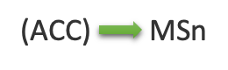
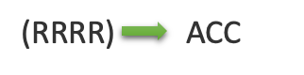
1 1 1 0 0 0 0 0
1 0 1 0 R R R R
1 1 1 0 0 1 S S
(ACC)
M
WRM
0000 for Register 0
0001 for Register 1
0010 for Register 2
0011 for Register 3
0100 for Register 4
0101 for Register 5
0110 for Register 6
0111 for Register 7
1000 for Register 8
1001 for Register 9
1010 for Register 10
1011 for Register 11
1100 for Register 12
1101 for Register 13
1110 for Register 14
1111 for Register 15
LD
00 for Character 0
01 for Character 1
10 for Character 2
11 for Character 3
1 1 1 1 0 0 0 1
WRn
CY
CLC
0
1 1 0 1 D D D D
1 1 1 1 1 0 1 0
DDDD
ACC
4-bit data item
CY
1
STC
LDM

Slide 13
1 1 1 1 1 0 0 0
1 0 1 1 R R R R
1 1 1 0 0 0 0 1
(ACC) - 1
ACC
(ACC)
RAM Output Register
0000 for Register 0
0001 for Register 1
0010 for Register 2
0011 for Register 3
0100 for Register 4
0101 for Register 5
0110 for Register 6
0111 for Register 7
1000 for Register 8
1001 for Register 9
1010 for Register 10
1011 for Register 11
1100 for Register 12
1101 for Register 13
1110 for Register 14
1111 for Register 15
DAC
WMP
1 1 1 0 1 0 0 0
1 1 1 0 0 0 1 0
(ACC)
(M) + (ACC) + (CY) ACC, CY
ACBR
(ACC)
ROM Output Lines
(RRRR)
ACC
SBM
(ACBR)
WRR
RRRR
1 1 1 1 0 0 1 0
1 1 1 1 0 0 0 0
(ACC) + 1
ACC
0
ACC
CY
IAC
0
XCH
CLB

Slide 14
1 1 1 1 1 1 0 1
1 1 1 0 0 0 1 1
CM0
a0
CM1
a1
Data RAM Chip 0 Program RAM
CM2
DCL
a2
1 1 1 1 0 0 1 1
0x4A9
Register 0
4 A B
0x4AA
Register 1
0x4AB
Register 2
0x4AC
CY
(CY)
CMC
Register 3
0x4AD
0x4AE
1 1 1 1 0 1 0 0
Status Characters
a₃ a₂ a₁ a₀
ACC
CMA
(ACC)
WPM
(PRAM)

Slide 15
1 1 1 1 0 1 0 1
1 1 1 1 0 1 1 0
a₀
CY
(CY)
a₀
a_{i+1}
a_{i-1}
a_{i}
a_{i}
CY
a₃
a₃
CY
Carry
Accumulator
Accumulator
Carry
Before RAL
0
1 1 0 1
Before RAR
0 1 1 0
1
RAL operation
0
1 1 0 1
RAR operation
0 1 1 0
1
1 0 1 1
0
After RAL
1
1 0 1 0
After RAR
RAL
RAR

Slide 16
1 1 1 1 0 1 1 1
1 1 1 0 0 1 S S
0 0 1 1 R_{p} R_{p} R_{p} 0
ACC
General representation of a byte
0
Least significant bit of the accumulator
a₀
(CY)
00 for Character 0
01 for Character 1
10 for Character 2
11 for Character 3
CY
0
TCC
1 1 1 0 1 0 1 1
MSn ACC
RDn
(M) + (ACC) + (CY) ACC, CY
1 1 1 0 1 0 1 0
ADM
(ROM input lines) ACC
1 1 1 0 1 0 0 1
I₃ O₂ O₁ I₀ (ACC) 1 X X 0 1 1 (1 or 0) (1 or 0) 0 ROM pins
(M) ACC
RDM
RDR

Slide 17
Multi-digit Addition
3
8
1
C
6 9 F 2 +
A
2
0
E
Data RAM chip 0 before addition
Carry = 1
Carry = 1
Carry = 0
Register 0
C 1 8 3 0 0 0 0 0 0 0 0 0 0 0 0
Register 1
2 F 9 6 0 0 0 0 0 0 0 0 0 0 0 0
Register 2
Register 3
Status Characters
Data RAM chip 0 after addition
Register 0
C 1 8 3 0 0 0 0 0 0 0 0 0 0 0 0
Register 1
E 0 2 A 0 0 0 0 0 0 0 0 0 0 0 0
Register 2
Register 3
Status Characters

Slide 18
Introduction date: |  | November 15, 1971
Type: |  | 4-bit microprocessor (8-bit instructions)
Frequency: |  | 500KHz - 740KHz
Technology: |  | P-channel silicon gate MOS technology
Number of transistors: |  | 2,300 (10 microns)
Addressable Memory |  | 4096x8-bit ROM and 1280x4-bit RAM
Number of Instructions |  | 45 with a 4 level stack and sixteen 4-bit (or eight 8-bit) registers
History: |  | In 1969 Busicom asked Intel to design a set of chips to be used in a new high perfomance calculator. Ted Hoff, Federico Faggin and Stan Mazor came up with a design that involved a central processing unit, 4004 (CPU) a read-only memory, 4001 (ROM) a random access memory, 4002 (RAM) and a shift register, 4003 (I/O). The CPU was eventually to be called a microprocessor. Later Intel negotiated for a return of the rights for the chips, which had gone to Busicom in the original contract.
Second source: |  | National Semiconductors was the only second source to Intel 4004.
Reset
9
8
Sync-Out
Test
10
7
Clk Phase 2
Memory
Control
Output
CM-ROM
Clk Phase 1
11
6
V_{DD}
12
5
V_{SS}
i4004
PINS
CM-RAM3
13
4
D3
9
8
10
7
CM-RAM2
14
3
D2
11
Memory
Control
Outputs
Data
Bus
I/O
6
12
5
CM-RAM1
15
2
D1
13
4
3
CM-RAM0
16
1
D0
14
15
2
16
1

Slide 19
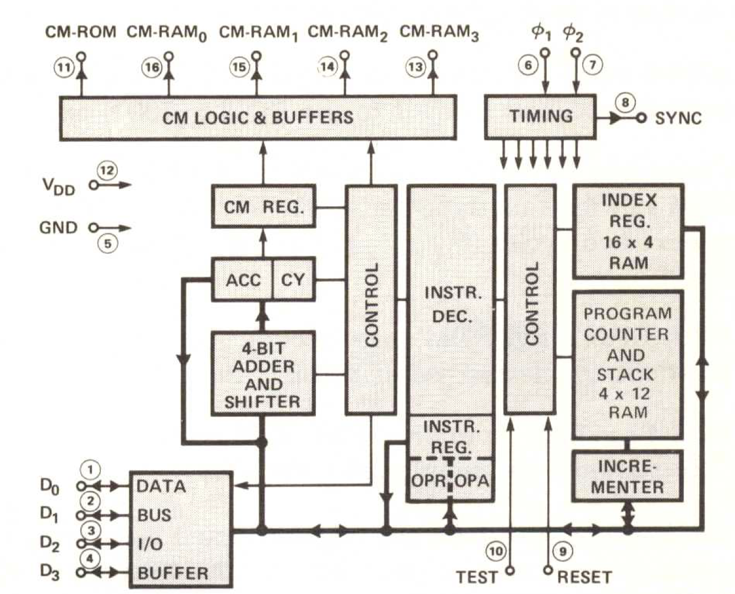
CM-ROM
CM-RAM₀
CM-RAM₀
CM-RAM₀
CM-RAM₀
⏀₁
⏀₂
Intel 4004
11
16
15
14
13
6
7
CM LOGIC AND BUFFERS
TIMING
SYNC
8
CM REGISTER
INSTRUCTION
DECODER
INDEX REGISTER
16 X 4 RAM
INSTRUCTION
DECODER
ACC
CY
PROGRAM COUNTER & STACK
4 X 12 RAM
V_{DD}
12
CONTROL
CONTROL
GND
5
INSTRUCTION
REGISTER
4-BIIT
ADDER
AND SHIFTER
OPR
OPA
INCREMENTER
DATA
BUS
I/O
BUFFER
D₀
1
D₁
2
D₂
3
D₃
4
10
9
TEST
RESET

Slide 20
Introduction date: |  | 1971
Type: |  | 10-bit Serial-in/Parallel-out, Serial-out Shift Register.
Memory: |  | 256 x 8-bit
Technology: |  | P-channel silicon gate MOS technology
Number of transistors:
History: |  | The 4003 was designed to be used with other MCS-4/40 devices such as the 4004 CPU.
Second Source |  | National Semiconductors was the only second source.
Q₅
9
8
Q₄
Q₆
10
7
Q₃
Parallel
Output
Parallel
Output
Q₇
11
Q₂
6
Q₈
12
5
V_{SS}
i4003
PINS
Q₉
13
4
Q₁
9
8
Parallel
Output
10
7
O₂
14
3
Q₀
11
6
12
5
Serial Out
O₁
15
2
Data In
13
4
3
Enable Input
O₀
16
1
Clock Pulse Input
14
15
2
16
1

Slide 21
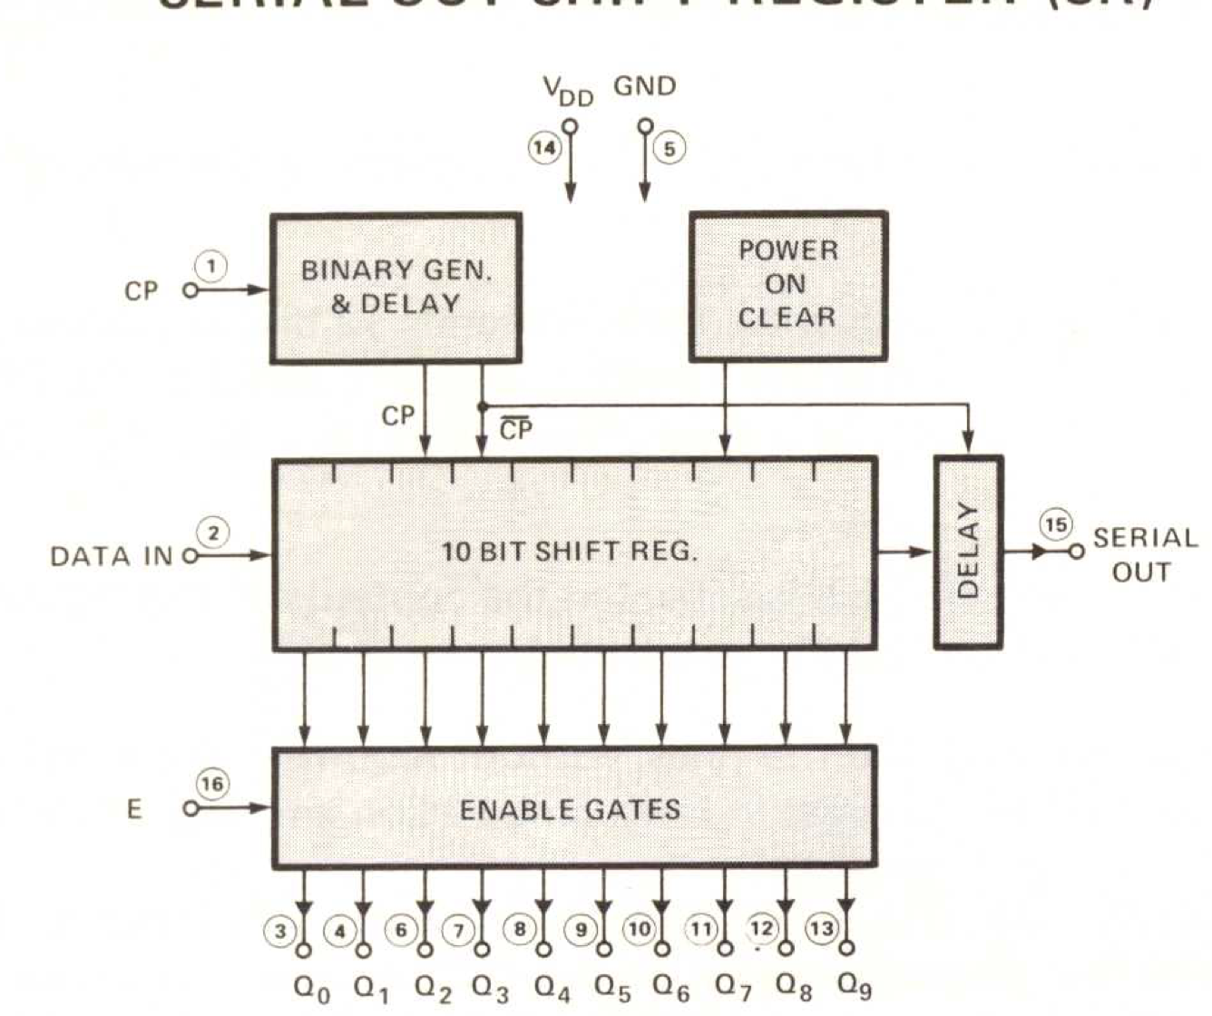
V_{DD}
GND
Intel 4003
BINARY GEN. & DELAY
14
5
POWER ON CLEAR
CP
1
CP
CP
10 BIT SHIFT REGISTER
DATA IN
DELAY
SERIAL OUT
2
15
ENABLE GATES
E
16
3
4
6
7
8
9
10
11
12
13
Q₀
Q₁
Q₂
Q₃
Q₄
Q₅
Q₆
Q₇
Q₈
Q₉

Slide 22
Introduction date: | 1971
Type: | 320-bit MOS RAM and 4-bit output port.
Memory: | 80 x 4-bit
Technology: | P-channel silicon gate MOS technology
History: | The 4002 was designed to be used with other MCS-4/40 devices such as the 4004 CPU. The chip was available in two different metal options 4002-1 and 4002-2 this was to make it possible to extend the chip selection so that 4pcs of 4002 chips could be connected to the 4004 CPU without any external chip selection logic.
Second source: | National Semiconductors was the only second source.
Reset
9
8
Sync-Out
Chip Select
Input
P₀
10
7
Clk Phase 2
Memory
Control
Input
CM
Clk Phase 1
11
6
V_{DD}
12
5
V_{SS}
i4002
PINS
O₃
13
4
D3
9
8
10
7
O₂
14
3
D2
11
Output
Lines
Data
Bus
I/O
6
12
5
O₁
15
2
D1
13
4
3
O₀
16
1
D0
14
15
2
16
1

Slide 23
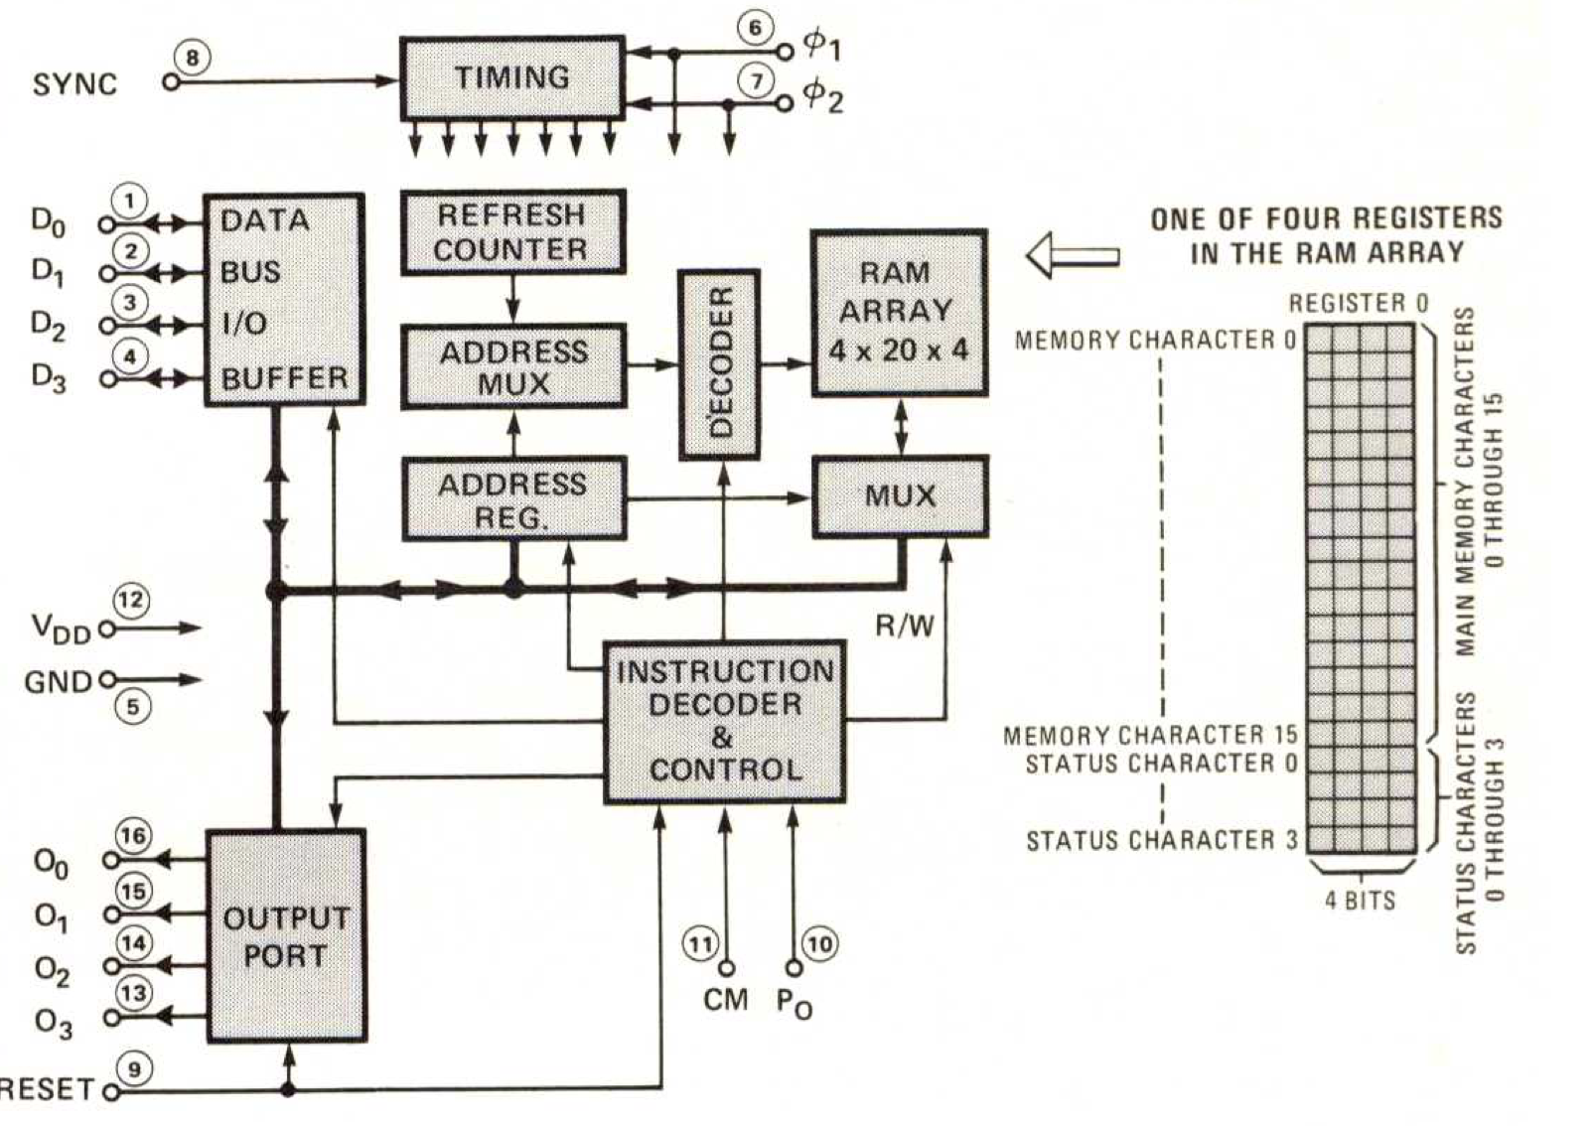
X₂
X₃
D₃ D₂
Chip #
(0 through 3)
D₁ D₀
Register #
(0 through 3)
D₃ D₂ D₁ D₀
Main Memory Character #
(0 through 15)
ONE OF THE 4 REGISTERS
IN THE RAM ARRAY
Register 0
TIMING
6
⏀₁
MEMORY CHARACTER 0
Intel 4002
SYNC
8
7
⏀₂
DATA
BUS
I/O
BUFFER
REFRESH
COUNTER
D₀
1
RAM
ARRAY
4 X 20 X 4
D₁
2
ADDRESS
MUX
DECODER
D₂
3
D₃
4
ADDRESS
REGISTER
MAIN MEMORY CHARACTERS
0 THROUGH 15
MUX
V_{DD}
12
GND
5
INSTRUCTION DECODE & CONTROL
R/W
I/O₀
16
OUTPUT PORT
I/O₁
MEMORY CHARACTER 15
15
I/O₂
STATUS CHARACTER 0
14
I/O₃
13
11
10
STATUS CHARACTERS
0 THROUGH 3
CM
P₀
RESET
9
STATUS CHARACTER 3
4-bits

Slide 24
0₂
13
12
V_{SS}
C₂
13
12
V_{SS}
0₁
14
11
SYNC
C₁
14
11
C₃
Introduction date: | 1971
Type: | Standard memory and I/O Interface set
Memory: | 80 x 4-bit
Technology: | P-channel silicon gate MOS technology
History: | The standard memory and I/O interface set (4008/4009) provides the complete control functions performed by the 4001 in MCS-4 systems. The 4008/4009 are completely compatible with other members of the MCS-4 family. All activity is still under control of the 4004 CPU.
Second source: | N/A
CM-ROM
15
10
OUT
C₀
15
10
W
I/O₃
16
9
IN
A₇
16
9
F/L
I/O₂
17
8
D₄
A₆
17
8
0₂
13
4
13
4
I/O₁
18
7
D₃
A₅
18
7
0₁
i4009
i4008
I/O₀
19
6
D₂
A₄
19
6
SYNC
D₃
20
5
D₁
A₃
20
5
CM-ROM
D₂
21
4
D_{o}
A₂
21
4
D₃
D₁
22
3
D₇
A₁
22
3
D₂
D₀
23
2
D₆
A₀
23
2
D₁
V_{DD}
24
1
D₅
V_{DD}
24
1
D₀

Slide 25
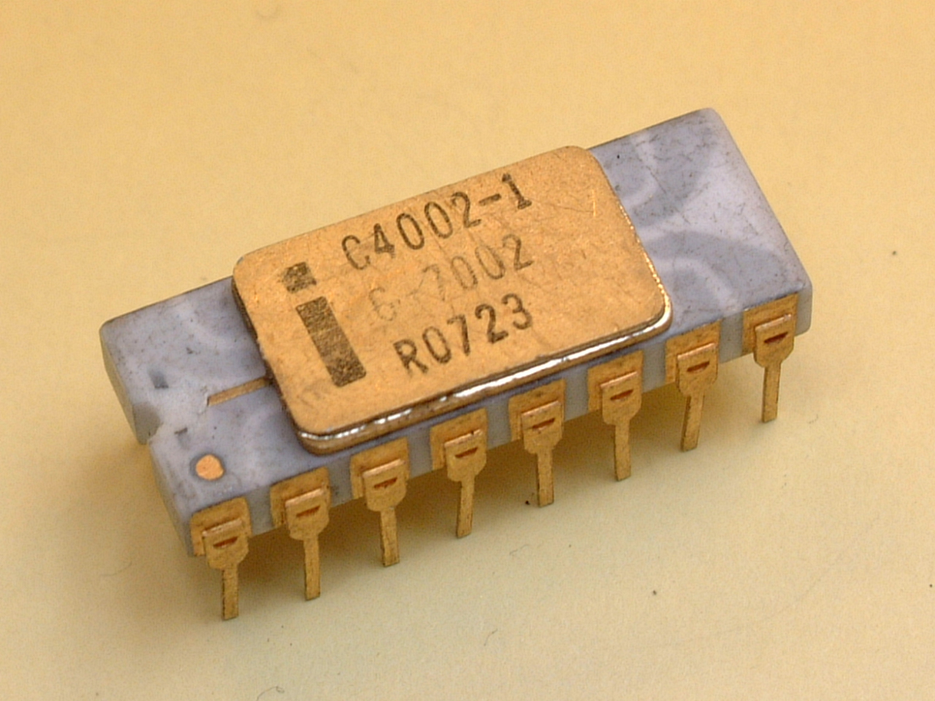
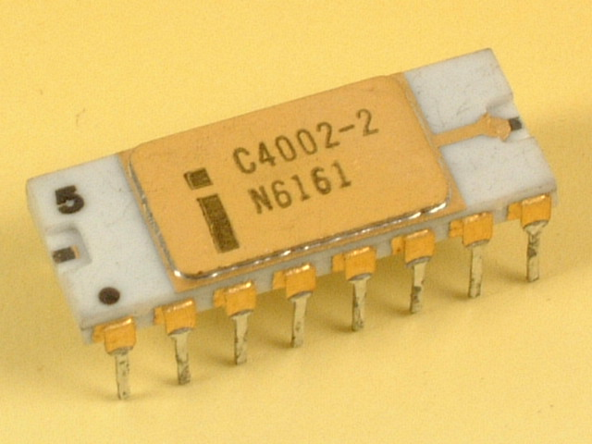

Slide 26
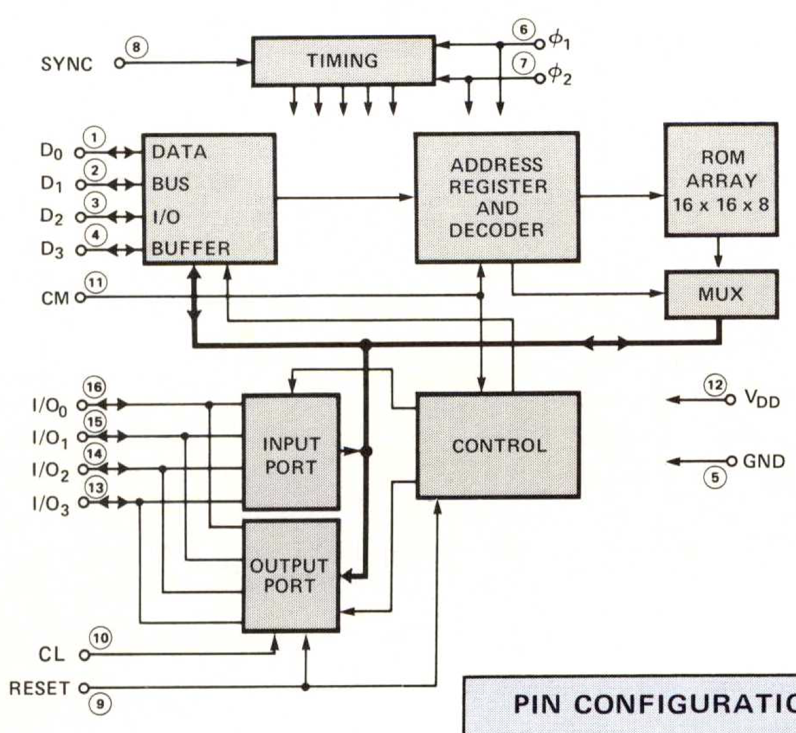
Introduction date: | 1971
Type: | Fully Decoded Static Random Access Memory..
Memory: | 256 x 8-bit
Technology: | P-channel silicon gate MOS technology (10 microns)
Number of transistors:
History: | The 4001 is a 256 x 8-bit ROM designed to be used with other MCS-4/40 devices such as the 4004 CPU.
Reset
9
8
Sync-Out
Clear input
I/O Lines
P₀
10
7
Clk Phase 2
Memory
Control
Input
CM
Clk Phase 1
11
6
-15v V_{DD}
5
V_{SS}
12
i4001
PINS
O₃
13
4
D3
9
8
10
7
O₂
14
3
D2
11
Output
Lines
Data
Bus
I/O
6
12
5
O₁
15
2
D1
13
4
3
O₀
16
1
D0
14
15
2
16
1

Slide 27
TIMING
6
⏀₁
Intel 4001
SYNC
8
7
⏀₂
DATA
BUS
I/O
BUFFER
ADDRESS
REGISTER
AND
DECODER
ROM
ARRAY
16 X 16 X 8
D₀
1
D₁
2
D₂
3
D₃
4
CM
11
MUX
I/O₀
16
I/O₁
INPUT PORT
CONTROL
15
V_{DD}
I/O₂
14
12
I/O₃
13
GND
5
OUTPUT PORT
CL
10
RESET
9

Slide 28
Individual Registers
Register Layout
Register 0
0
1
Register 1
Decimal
Address
Hexadecimal
Address
Register 2
2
3
Register 3
8 Bits
Register 4
4
5
Register 5
0
255
256
511
3840
4095
0
FF
100
1FF
F00
FFF
Register 6
6
7
Register 7
Page 0
Register 8
8
9
Register 9
Register 10
10
11
Register 11
Register 12
12
13
Register 13
Page 1
Register 14
14
15
Register 15
Register Pair 0 or 0P
0
1
Register Pair 2 or 1P
2
3
Register Pair 4 or 2P
4
5
Register Pair 6 or 3P
6
7
Register Pair 8 or 4P
8
9
Register Pair 10 or 5P
10
11
Page 15
Register Pair 11 or 6P
12
13
Register Pair 12 or 7P
14
15
Register Pairs

Slide 29
Data RAM bank organisation
DCL Instruction selects 1 of 8 Data RAM banks
Data RAM Chip 0
Data RAM Chip 0
Data RAM Chip 0
Data RAM Chip 1
Data RAM Chip 1
Data RAM Chip 1
Data RAM Chip 2
Data RAM Chip 2
Data RAM Chip 2
Data RAM Chip 3
Data RAM Chip 3
Data RAM Chip 3
Data RAM bank 0
Data RAM bank 1
Data RAM bank 7

Slide 30

Data RAM chip 0 organisation
4 Specially Addressable 4-bit
status characters per Data RAM Register
Decimal
Address
Hexadecimal
Address
16 Directly Addressable 4-bit characters per Data RAM Register
0 - 15
00 – 0F
Data RAM Register 0
16 - 31
10 – 1F
Data RAM Register 1
32 - 47
20 – 2F
Data RAM Register 2
48 - 63
30 – 3F
Data RAM Register 3
value
a
Pointer
“a” represents an address
Misc.
Stack 1

Slide 31
Stack 2 - Write
After 2 writes
After 3 writes
After 4 writes
a
a
d
b
b
b
c
c
a, b, c, d represent any 4 memory addresses
represents the stack pointer
Stack 3 - Read
First read:
Address d is read
Second read:
Address c is read
Third read:
Address b is read
d
d
d
b
b
b
c
c
c
b, c, d represent any 4 memory addresses
represents the stack pointer

Slide 32
Index Register to Accumulator
Accumulator
0 1 X X R R R R
1 1 1 1 X X X X
00 for ADD
01 for SUB
10 for LD
11 for XCH
0000 for Register 0
0001 for Register 1
0010 for Register 2
0011 for Register 3
0100 for Register 4
0101 for Register 5
0110 for Register 6
0111 for Register 7
1000 for Register 8
1001 for Register 9
1010 for Register 10
1011 for Register 11
1100 for Register 12
1101 for Register 13
1110 for Register 14
1111 for Register 15
0000 for CLB
0001 for CLC
0010 for IAC
0011 for CMC
0100 for CMA
0101 for RAL
0110 for RAR
0111 for TCC
1000 for DAC
1001 for TCS
1010 for STC
1011 for DAA
1100 for KBP

Slide 33
I/O and Ram Instructions
Equate
Label Code Operand
Sym = Exp
1 1 1 0 X X X X
Required symbol
Required expression
Origin
Label Code Operand
= Exp
0000 for WRM
0001 for WMP
0010 for WRR
0011 for WPM
0100 for WR0
0101 for WR1
0110 for WR2
0111 for WR3
1000 for SBM
1001 for RDM
1010 for RDR
1011 for ADM
1100 for RD0
1101 for RD1
1110 for RD2
1111 for RD3
Blank label field
Required expression
Label Code Operand
= Exp
Required expression

Slide 34
Crossing Page Boundaries - 1
Crossing Page Boundaries - 2
Decimal Address
0
200
253
255
Page 0
P1, LDM 0
JCN 12 P1
XCH 3
Decimal Address
0
200
254
256
456
511
Page 0
P1, LDM 0
NEW INSTRUCTION
JCN 12 P1
Page 1
XCH 3

Slide 35
Subroutines
Arbitrary Memory
Address (hex)
3C0
3C2
401
403
P1, JMS IN
JMS IN
IN,
BBL 0
First subroutine call
Second subroutine call
While IN is
executing
After BBL is
performed
Before JMS
ADDR 1
3C2H
3C2H
ADDR 2
ADDR 2
ADDR 2
ADDR 3
ADDR 3
ADDR 3

Slide 36
Pseudosubroutine
Main
Program
Branch
Table
Program
Jump
Routines
XOR
OR
0 1
0 1
0
0
1
0
0
1
1
1
0
1
1
1
AND
0 1
0
0
0
Normal subroutine return
sequence not followed by
Branch Table Program
1
0
1
Floating Point Numbers
RAM Chip
Register 0
1 2 3 4 5 6 7 8 9 0 8 1 2 4 8 9
2
3
1
0
Register 1
Register 2
Register 3
Data Characters
Status Characters

Slide 37
Computer Program Representation in Memory
Direct Addressing
Memory Address
(hexadecimal)
Instruction
Number
Program Counter Contents
(hexadecimal)
Arbitrary Memory
Address
(hexadecimal)
Memory
0x139
any - 1
Jump
Instruction
0x13A
1 0x13A
any
43
0x13B
any + 1
A2
2 0x13B
0x13C
.
0x13D
.
3 0x13D
Address
0x3A2
Specified
0x13E
0x3A2
0x13F
4 0x13F
0x3A3
0x140
0x3A4
5 0x140
0x141
0x3A5
0x142
0x3A6

Slide 38
Indirect Addressing
Same Page Addressing
Memory
Address
(hexadecimal)
Memory
Register Pair 4
Memory
Address
(hexadecimal)
Memory
1
0x1FF
B
0x200
35
0x30E
0x201
0x30F
.
0x310
.
.
0x21B
.
0x21C
0x3A0
12
Code for Jump on Condition 2
0x3A1
0F
Address within this page
0x21D
0x3A6
Memory
Indirect Addressing
D3

Slide 39
Subroutines and use of the
Stack for Addressing 1
Main Program
Program
Program
Addition
Program
Call Instruction
Program
Addition
Subroutine
Addition
Program
Next Instruction
Program
etc….
Addition
etc….

Slide 40
Memory
Address
(hexadecimal)
Memory
Instruction
Comments
Write address of next
instruction 0xC05 to
the stack
0xC01
Subroutines and use of the
Stack for Addressing 2
0xC02
0xC03
Call Subroutine at 0xF02
0xC04
Next instruction
0xC05
0xC06
0xC07
Branch to
subroutine
.
.
0xEFF
.
Return
to next
instruction
0xF00
0xF01
0xF02
First Subroutine instruction
0xF03
0xF04
Body of Subroutine
.
0xF4D
0xF4E
0xF4F
Return
Read return address (0xC05) from the stack
0xF50

Slide 41
Assembly Language 1
Memory Address
(hexadecimal)
Memory Address
(hexadecimal)
Old content
New content
0x331
0x331
0x332
F0
0x332
F0
F0
New Instructions
Moved Instructions
Changed Instructions
0x333
43
0x333
43
New Instruction
0x334
56
0x334
56
43
.
.
57
.
.
.
.
0x354
20
0x354
20
0x355
FF
0x355
FF
20
0x356
60
0x356
60
FF
0x357
0x357
60

Slide 42
Assembly Language 2
Assembly Language Program written by a programmer
Executable hexadecimal machine code
Assembler Program
SOURCE PROGRAM
OBJECT PROGRAM
Source program
Memory Address
(hexadecimal)
Object program
Source program
Memory Address
(hexadecimal)
Object program
0x331
0x331
NOW, CLB
JUN NXT
.
.
.
.
.
.
FIM 0 255
NXT, INC 0
0x332
F0
NOW, CLB
New Instruction
JUN NXT
.
.
.
.
.
.
FIM 0 255
NXT, INC 0
0x332
F0
0x333
43
0x333
??
0x334
56
0x334
43
ASSEMBLER
.
ASSEMBLER
0x335
57
.
.
.
.
0x354
20
0x355
20
0x355
FF
0x356
FF
0x356
60
0x357
60
0x357
0x358
New Instructions
Moved Instructions
Changed Instructions

Slide 43
Output from Busicom-141PF Calculator ROM disassembly - First 32 words
Pyntel4004 Disassembler
Source Code *
0 240 clb
1 17, 1 jcn(1,1)
3 80, 176 jms(176)
5 81, 95 jms(95)
7 173 ld(13)
8 177 xch(1)
9 240 clb
10 81, 95 jms(95)
12 173 ld(13)
13 28, 41 jcn(12,41)
15 104 inc(8)
16 81, 115 jms(115)
18 39 src(3)
19 236 rd0
20 245 ral
21 179 xch(3)
22 104 inc(8)
23 240 clb
24 81, 160 jms(160)
26 243 cmc
27 179 xch(3)
28 245 ral
29 225 wmp
30 102 inc(6)
31 39 src(3)
32 234 rdr
000 clb
001 jcn TZ $001
003 jms $0b0
005 jms $15f
007 ld 13
008 xch 1
009 clb
00a jms $15f
00c ld 13
00d jcn AN $029
00f inc 8
010 jms $173
012 src 3<
013 rd0
014 ral
015 xch 3
016 inc 8
017 clb
018 jms $1a0
01a cmc
01b xch 3
01c ral
01d wmp
01e inc 6
01f src 3<
020 rdr
* https://www.4004.com/2009/Busicom-141PF-Calculator_asm_rel-1-0-1.txt

Slide 44
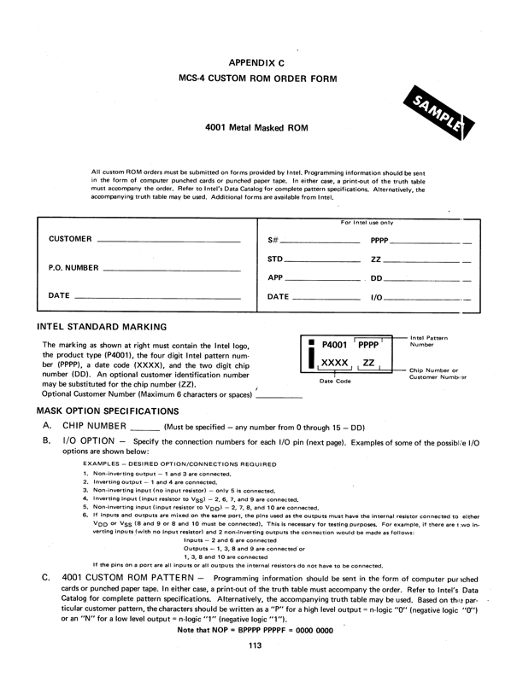

Slide 46
Ceramic Package Outline
.735
.830
.295
.325
PIN 1
.050
MAX
.055
.125
.260
.295
.045
.065
.200
MAX
.015
.023
_
+
.010 .002
.100 MIN
.020
.060
.290
.410
.010
.065
_
+
.032
REF.
.100 .010
TYP.

Slide 47
Plastic Package Outline
.745
.855
PIN 1
.060 / .070 REF.
.245
.255
.060 / .125
REF.
.290
.310
.025 REF.
.125
.155
.200
MAX
.290
.410
.015
.023
.008
.012
.100 MIN
.020
MIN
.045
.065
.290
.410
.025
.063
REF.
.090
.110
TYP.
.032
REF.

Slide 48
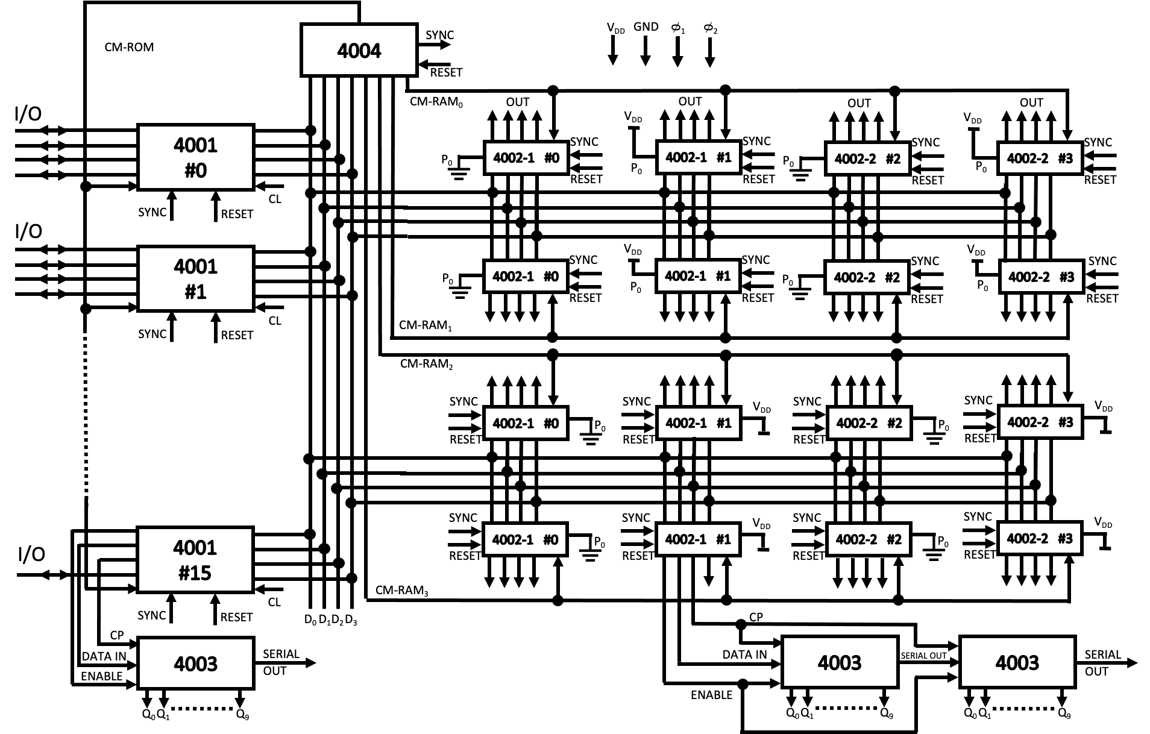
V_{DD}
GND
0
0
MCS-4 System Interconnection
4004
SYNC
₁
₂
CM-ROM
RESET
I/O
CM-RAM₀
OUT
OUT
OUT
OUT
V_{DD}
V_{DD}
4001
#0
SYNC
SYNC
SYNC
SYNC
⏚
4002-1 #0
4002-1 #1
⏚
4002-2 #2
4002-2 #3
P₀
P₀
P₀
P₀
RESET
RESET
RESET
RESET
SYNC
CL
I/O
RESET
4001
#1
SYNC
V_{DD}
SYNC
SYNC
V_{DD}
SYNC
⏚
4002-1 #0
4002-1 #1
⏚
4002-2 #2
4002-2 #3
P₀
P₀
P₀
P₀
RESET
RESET
RESET
RESET
SYNC
CL
CM-RAM₁
RESET
CM-RAM₂
SYNC
SYNC
V_{DD}
SYNC
SYNC
V_{DD}
4002-1 #0
⏚
P₀
4002-1 #1
4002-2 #2
⏚
P₀
4002-2 #3
RESET
RESET
RESET
RESET
SYNC
SYNC
V_{DD}
SYNC
SYNC
V_{DD}
4001
#15
4002-1 #0
⏚
P₀
4002-1 #1
4002-2 #2
⏚
P₀
4002-2 #3
I/O
RESET
RESET
RESET
RESET
CL
CM-RAM₃
SYNC
RESET
D₀
CP
D₁
D₂
D₃
CP
DATA IN
4003
SERIAL
OUT
DATA IN
4003
SERIAL OUT
4003
SERIAL
OUT
ENABLE
ENABLE
Q₀
Q₁
Q₉
Q₀
Q₀
Q₁
Q₉
Q₁
Q₉

Slide 49
INSTRUCTION CYCLE
MCS-4 Basic Instruction Cycle
Instruction sent
to CPU from ROM
Execution of Instruction
Address sent from ROM to CPU
Data is operated on in the CPU, or
Data or address is sent to/from CPU
1.35µs
0
₁
0
₂
SYNC
Memory
Subcycles
X₃
A₁
A₂
A₃
M₁
M₂
X₁
X₂
X₃
If IOR⁽¹⁾ the selected 4001 or 4002 are enabled, otherwise the CPU is enabled
Device
Controlling
Data Bus
Output
The CPU is enabled
The selected 4001 is enabled
The CPU is enabled
The CPU is enabled
Data Bus
Contents
Lower 4-bit address to ROMs.
Middle 4-bit address to ROMs.
Higher 4-bit address to ROMs. (Chip select code)
Instruction to CPU
OPA Out
Data or Address to ROMs and RAMs if IO⁽¹⁾ or SRC⁽²⁾
Data to CPU if IOR⁽¹⁾
Address to RAMs if SRC⁽²⁾
OPR to CPU
OPA to CPU and ROMs and RAMs if IO⁽¹⁾
(Not Used)
(1) IO instructions control the flow of information between the accumulator in the CPU, I/O lines in ROMs and RAMs and RAM storage.
IOR stands for I/O Read. In this case, the CPU will receive data from RAM storage locations or I/O input lines of 4001
(2) The SRC instruction designates the chip number and address for a following I/O instruction.

Slide 50
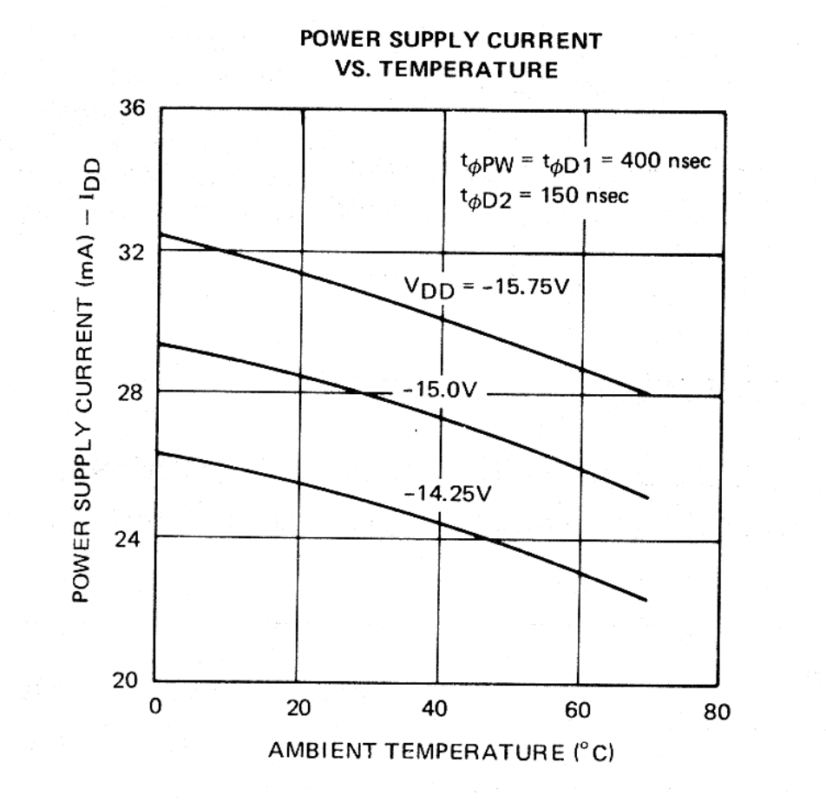
4004 Typical DC Characteristics
Power Supply Current
Vs. Temperature
t _{PW} = t _{PW} = 400nsec
_{I}
_{I}
0
0
t _{D2} = 400nsec
_{I}
0
V_{DD} = -15.75V
Power Supply Current (mA) - I_{DD}
-15.0V
-14.25V
Ambient Temperature (ºC)

